Slide 1

Wipro - Ericsson Tech Day 2026
ENIQ AI DevOps Assistant
Intelligent DevOps automation for project delivery teams
Category: AI in Project Management
Kiro AI Engine
One conversational interface to ask, trace, diagnose and summarize across JIRA, Jenkins, Gerrit and Confluence.
Wipro - Ericsson Tech Day 2026 | AI in Project Management
01
Notes:
[Sources] - ENIQ_AI_Assistant_Demo.md: title, event positioning, powered by Kiro AI Engine, and tool integration content. - Visual on this slide was generated with Microsoft Copilot.

Slide 2
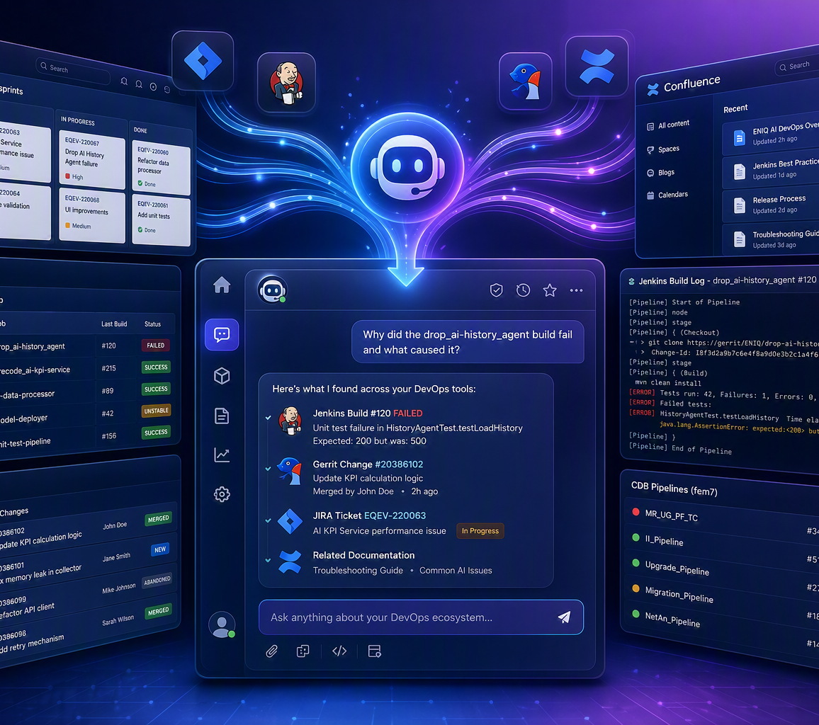
CURRENT PROJECT-MANAGEMENT FRICTION
Overview: Why This Matters
Multiple Tools
Context Switching
Engineers move between JIRA, Jenkins, Gerrit and Confluence during daily investigations.
Build failures, code changes and user stories require correlating information across several systems.
Manual Analysis
Knowledge Silos
Log analysis and platform searches consume time and slow project follow-up.
New engineers need help navigating CI/CD pipelines and team documentation.
Need: a single intelligent assistant that understands context and correlates project data across DevOps tools.
Wipro - Ericsson Tech Day 2026 | AI in Project Management
02
Notes:
[Sources] - ENIQ_AI_Assistant_Demo.md: problem statement and need for a single intelligent assistant. - Visual on this slide was generated with Microsoft Copilot.

Slide 3
CONVERSATIONAL AI FOR PROJECT EXECUTION
Solution: ENIQ AI DevOps Assistant
AI-Powered Chat
Per-User Credentials
Natural-language queries processed by Kiro AI.
Users configure secure personal tokens for each service.
AI
Assistant
Session Persistence
Tool Integrations
Follow-up questions keep conversation context per user.
JIRA, Jenkins fem6/fem7, Gerrit and Confluence access.
Project-management value: teams can ask one question and receive a correlated answer instead of manually stitching data across tools.
Wipro - Ericsson Tech Day 2026 | AI in Project Management
03
Notes:
[Sources] - ENIQ_AI_Assistant_Demo.md: AI chat, per-user credentials, session persistence and tool integrations.

Slide 4
BROWSER -> BACKEND -> AI ENGINE -> ENTERPRISE TOOLS
Architecture Diagram
Browser UI
E-UI SDK / Lit Web Components | Port 5000
/api/* proxy
Secure
per-user
tokens
Flask Backend
Port 5050 | Routes -> Controllers -> Services -> Integrations
Service calls
Kiro CLI Engine
AI reasoning + tool execution
JIRA
Jenkins
Gerrit
Confluence
Alpha | tickets and user stories
fem6/fem7 | build status and logs
Gamma | code reviews and diffs
eteamspace | documentation search
Wipro - Ericsson Tech Day 2026 | AI in Project Management
04
Notes:
[Sources] - ENIQ_AI_Assistant_Demo.md: architecture components and ports; JIRA, Jenkins, Gerrit and Confluence integration labels.

Slide 5
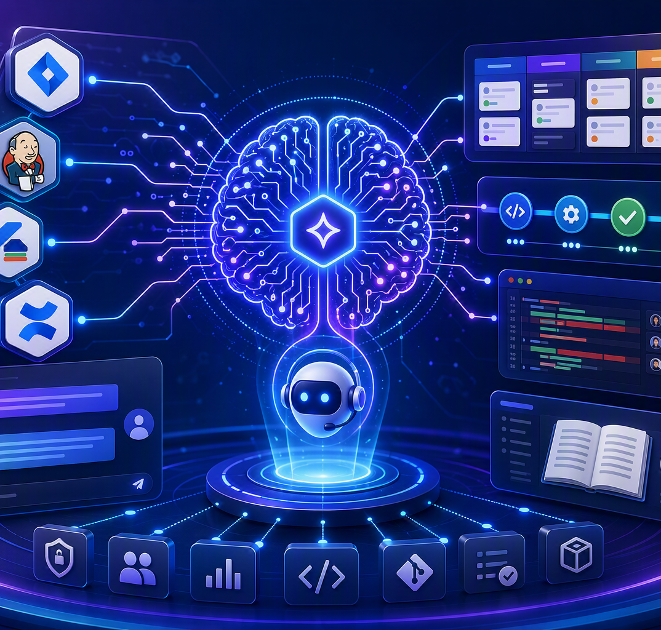
IMPACT FOR AI IN PROJECT MANAGEMENT
Benefits and Tech Day Takeaway
Measurable benefits
Metric
Before
After
Build failure diagnosis
15-30 min
< 1 min
Tools open simultaneously
4-5
1
New engineer onboarding
Days
Hours
Context switches / investigation
10+
0
Project delivery value
Roadmap direction
Tech Day message
Natural-language investigation, consistent summaries and audit trail for every user query.
Dashboard health views, automated alerts, proactive suggestions and usage analytics.
AI transforms project management from manual coordination to context-aware execution support.
Wipro - Ericsson Tech Day 2026 | AI in Project Management
05
Notes:
[Sources] - ENIQ_AI_Assistant_Demo.md: benefit metrics, additional benefits and future roadmap. - Visual on this slide was generated with Microsoft Copilot.

